Slide 1

PYTHON PROGRAMMING & DATA SCIENCE

Slide 2
Data Visualization
Data Visualization
Data Visualization is the presentation of data in graphical format.
It helps in understands the significance of data by summarizing and presenting huge amount of data in a simple and easy-to-understand format and helps communicate information clearly and effectively.
It enables stakeholders and decision makers to analyze data visually.
The data in a graphical format allows them to identify new trends and patterns easily.

Slide 3
Data Visualization
The main benefits of data visualization are as follows:
It simplifies the complex quantitative information
It helps analyze and explore big data easily
It identifies the areas that need attention or improvement
It identifies the relationship between data points and variables
It explores new patterns and reveals hidden patterns in the data
Three major considerations for Data Visualization:
Clarity
Accuracy
Efficiency

Slide 4
Data Visualization
Clarity -
Clarity ensures that the data set is complete and relevant.
Accuracy –
Accuracy ensures using appropriate graphical representation to convey the right message.
Efficiency -
Efficiency uses efficient visualization technique which highlights all the data points

Slide 5
Data Visualization
some basic factors to be aware of before visualizing the data.
Visual effect
Coordination System
Data Types and Scale
Informative Interpretation

Slide 6
Data Visualization
Visual effect -
Visual Effect includes the usage of appropriate shapes, colors, and size to represent the analyzed data.
Coordination System -
The Coordinate System helps to organize the data points within the provided coordinates.
Data Types and Scale -
The Data Types and Scale choose the type of data such as numeric or categorical.
Informative Interpretation –
The Informative Interpretation helps create visuals in an effective and easily interpreted ill manner using labels, title legends, and pointers.

Slide 7
Data Visualization
Python Libraries
Python offers multiple great graphing libraries .
Some popular plotting libraries:
Matplotlib
Pandas Visualization
Seaborn
ggplot
Plotly

Slide 8
Matplotlib
Matplotlib:
matplotlib is a python two-dimensional plotting library for data visualization and creating interactive graphics or plots.
Using pythons matplotlib, the data visualization of large and complex data becomes easy.
matplotlib Advantages
There are several advantages of using matplotlib to visualize data.
A multi-platform data visualization tool built on the numpy and sidepy framework. Therefore, it's fast and efficient.
It possesses the ability to work well with many operating systems and graphic backends.

Slide 9
Matplotlib
matplotlib Advantages:
It possesses high-quality graphics and plots to print and view for a range of graphs such as histograms, bar charts, pie charts, scatter plots and heat maps.
With Jupyter notebook integration, the developers have been free to spend their time implementing features rather than struggling with compatibility.
It has large community support and cross-platform support as it is an open source tool.
It has full control over graph or plot styles such as line properties, thoughts, and access properties.

Slide 10
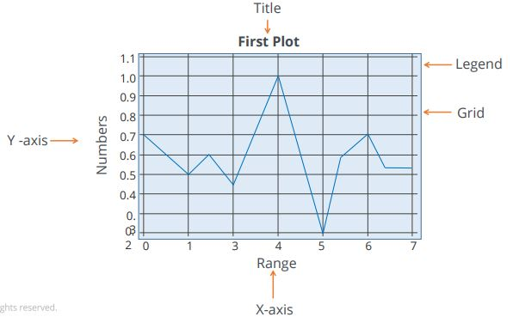
Matplotlib
Plot:
A plot is a graphical representation of data, which shows the relationship between two variables or the distribution of data.
Example:
This is a line plot of the random numbers on the y-axis and the range on the x-axis. The background of the plot is called a grid. The text first plot denotes the title of the plot and text line one denotes the legend.

Slide 11
Matplotlib
Plot:
plot() function draws a line from point to point.
The function takes parameters for specifying points in the diagram.
Parameter 1 is an array containing the points on the x-axis.
Parameter 2 is an array containing the points on the y-axis.
Example:
To plot a line from (1, 3) to (8, 10). pass two arrays as [1, 8] and [3, 10] to the plot function

Slide 12
Matplotlib
Creating a plot:
We can create a plot using four simple steps.
Import the required libraries
Define or import the required data set
Set the plot parameters
Display the created plot

Slide 13
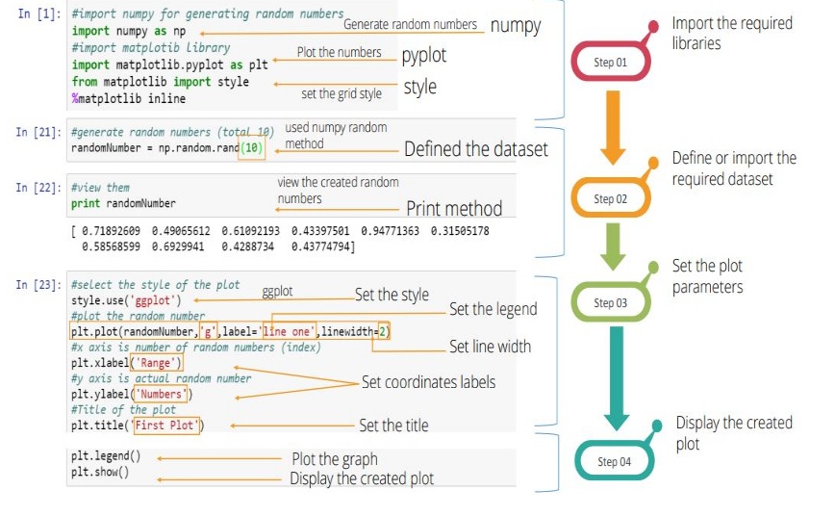
Matplotlib
Creating a plot:
Example:

Slide 14
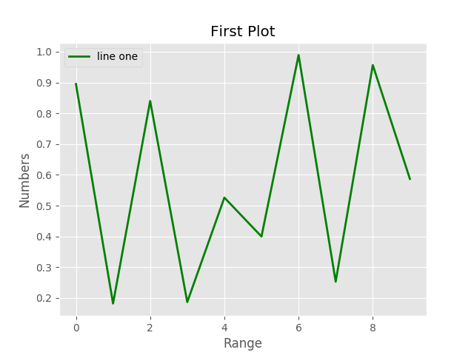
Matplotlib
Creating a plot:
Program:
import numpy as np
import matplotlib.pyplot as plt
from matplotlib import style
r=np.random.rand(10)
style.use('ggplot')
plt.plot(r,'g',label='line one',linewidth=2)
plt.xlabel('Range')
plt.ylabel('Numbers')
plt.title('First Plot')
plt.legend()
plt.show()
Output:

Slide 15
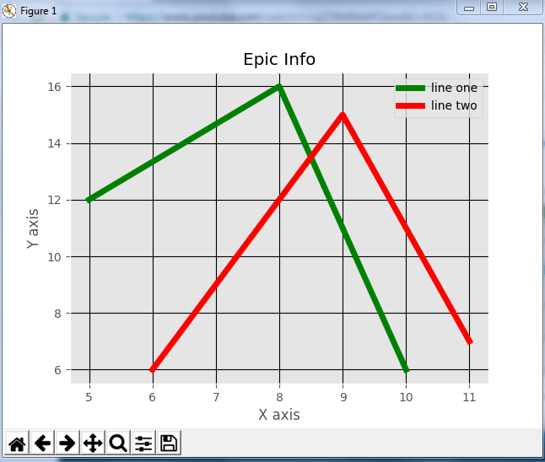
Matplotlib
Creating a plot:
Multiple Plots
from matplotlib import pyplot as plt
from matplotlib import style
style.use('ggplot')
x = [5,8,10] ,y = [12,16,6], x2 = [6,9,11]
y2 = [6,15,7]
plt.plot(x,y,'g',label='line one', linewidth=5)
plt.plot(x2,y2,'c',label='line two',linewidth=5)
plt.title('Epic Info')
plt.ylabel('Y axis')
plt.xlabel('X axis')
plt.legend()
plt.grid(True,color='k')
plt.show()
Output:

Slide 16
Matplotlib
Types of Plots:
The following type of plots can be created using matplotlib.
Histogram
Scatter Plot
Heat Map
Pie Chart
Error Bar , ….etc

Slide 17
Matplotlib
Scatter Plot:
scatter plots are used to compare variables.
The data is displayed as a collection of points, each having the value of one variable which determines the position on the horizontal axis and the value of other variable determines the position on the vertical axis.
scatter() function is used to draw a scatter plot.
It has several advantages:
It shows the correlation between variables
It is suitable for large data sets
It is easy to find clusters
It is possible to represent each piece of data as a point on the plot.

Slide 18
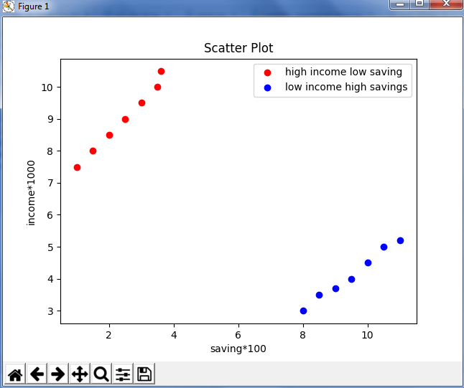
Matplotlib
Scatter Plot:
Example:
import matplotlib.pyplot as plt
x = [1,1.5,2,2.5,3,3.5,3.6]
y = [7.5,8,8.5,9,9.5,10,10.5]
x1=[8,8.5,9,9.5,10,10.5,11]
y1=[3,3.5,3.7,4,4.5,5,5.2]
plt.scatter(x,y, label='high income low saving',color='r')
plt.scatter(x1,y1,label='low income high savings',color='b')
plt.xlabel('saving*100')
plt.ylabel('income*1000')
plt.title('Scatter Plot')
plt.legend()
plt.show()

Slide 19
Matplotlib
Bar Graph:
A bar graph uses bars to compare data among different categories.
It is well suited when we want to measure the changes over a period of time.
It can be represented horizontally or vertically.
the bar() function is used to draw bar graphs.

Slide 20
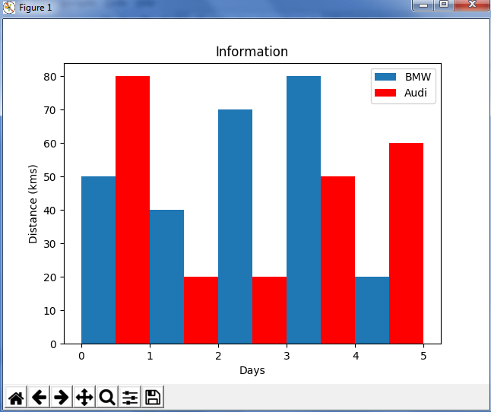
Matplotlib
Bar Graph:
Example:
from matplotlib import pyplot as plt
plt.bar([0.25,1.25,2.25,3.25,4.25],[50,40,70,80,20],
label="BMW",width=.5)
plt.bar([.75,1.75,2.75,3.75,4.75],[80,20,20,50,60],
label="Audi", color='r',width=.5)
plt.legend()
plt.xlabel('Days')
plt.ylabel('Distance (kms)')
plt.title('Information')
plt.show()

Slide 21
Matplotlib
Histograms:
Histograms are graphical representations of a probability distribution (normal distribution).
histogram is a kind of bar chart.
In Matplotlib Histogram is created using the hist() method.
The hist() function will use an array of numbers to create a histogram, the array is sent into the function as an argument.
A histogram chart has several advantages.
It displays the number of values within a specified interval.
It is suitable for large data sets as they can be grouped within the intervals.

Slide 22
Matplotlib
Histograms:
Example:
NumPy is used to randomly generate an array with 250 values, where the values will concentrate around 170, and the standard deviation is 10.
import numpy as np x = np.random.normal(170, 10, 250) print(x)
Result:
[167.62255766 175.32495609 152.84661337 165.50264047 163.17457988 162.29867872 172.83638413 168.67303667 164.57361342 180.81120541 170.57782187 167.53075749 176.15356275 176.95378312 158.4125473 187.8842668 159.03730075 166.69284332 160.73882029 152.22378865 164.01255164 163.95288674 176.58146832 173.19849526 169.40206527 166.88861903 149.90348576 148.39039643 177.90349066 166.72462233 177.44776004 170.93335636 173.26312881 174.76534435 162.28791953 166.77301551 160.53785202 170.67972019 159.11594186 165.36992993 178.38979253 171.52158489 173.32636678 159.63894401 151.95735707 175.71274153 165.00458544 164.80607211 177.50988211 149.28106703 179.43586267 181.98365273 170.98196794 179.1093176 176.91855744 168.32092784 162.33939782 165.18364866 160.52300507 174.14316386 163.01947601 172.01767945 173.33491959 169.75842718 198.04834503 192.82490521 164.54557943 206.36247244 165.47748898 195.26377975 164.37569092 156.15175531 162.15564208

Slide 23
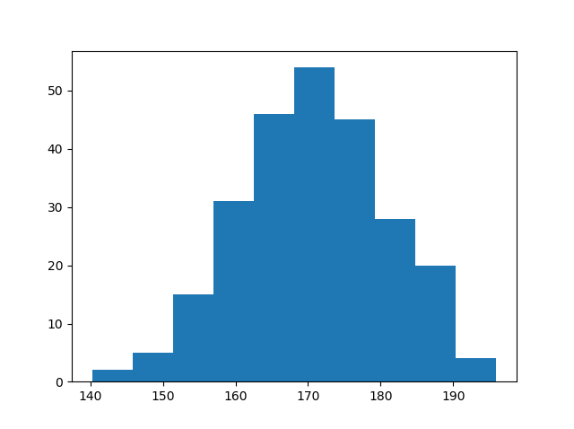
Matplotlib
Histograms:
Example:
import matplotlib.pyplot as plt import numpy as np x = np.random.normal(170, 10, 250) plt.hist(x) plt.show()
Output:

Slide 24
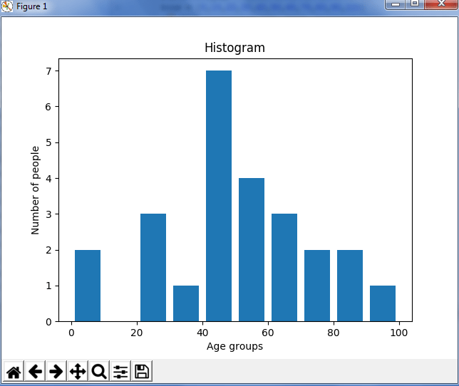
Matplotlib
Histograms:
Example 2:
import matplotlib.pyplot as plt
population_age = [22,55,62,45,21,22,34,42,42,4,2,102,95,
85,55,110,120,70,65,55,111,115,80,75,65,54,44,43,42,48]
bins = [0,10,20,30,40,50,60,70,80,90,100]
plt.hist(population_age, bins, histtype='bar',
rwidth=0.8)
plt.xlabel('age groups')
plt.ylabel('Number of people')
plt.title('Histogram')
plt.show()
Output:

Slide 25
Matplotlib
Heat Maps
A heat map is a better way to visualize two-dimensional data.
Using heat maps, we can gain deeper and quicker insight into data than those afforded by other types of plots.
It has several advantages:
It draws attention to the risky-prone area.
It uses the entire data set to draw bigger and more meaningful insights.
It's used for cluster analysis and deals with large data sets.

Slide 26
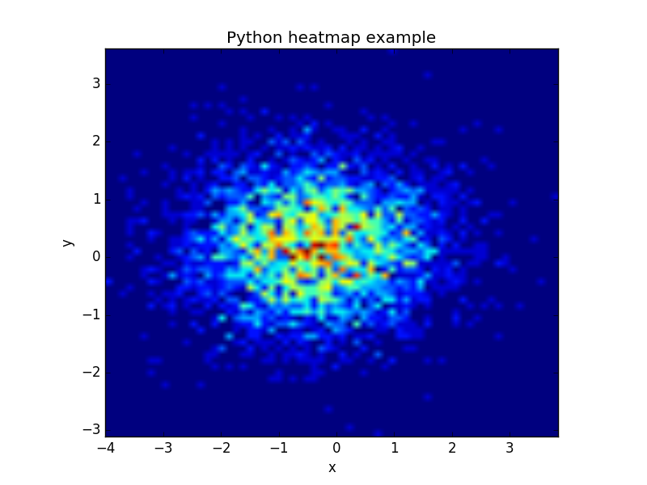
Matplotlib
Heat Maps
import numpy as np import numpy.random import matplotlib.pyplot as plt # Create data x = np.random.randn(4096) y = np.random.randn(4096) # Create heatmap heatmap, xedges, yedges = np.histogram2d(x, y, bins=(64,64)) extent = [xedges[0], xedges[-1], yedges[0], yedges[-1]] # Plot heatmap plt.clf() plt.title('Pythonspot.com heatmap example') plt.ylabel('y') plt.xlabel('x') plt.imshow(heatmap, extent=extent) plt.show()
Output:

Slide 27
Matplotlib
Box Plot:
A Box Plot is also known as Whisker plot is created to display the summary of the set of data values having properties like minimum, first quartile, median, third quartile and maximum.
In the box plot, a box is created from the first quartile to the third quartile, a verticle line is also there which goes through the box at the median.
Here x-axis denotes the data to be plotted while the y-axis shows the frequency distribution.
boxplot() function is used to create box plots.
matplotlib.pyplot.boxplot(data, notch=None, vert=None, patch_artist=None, widths=None)

Slide 28
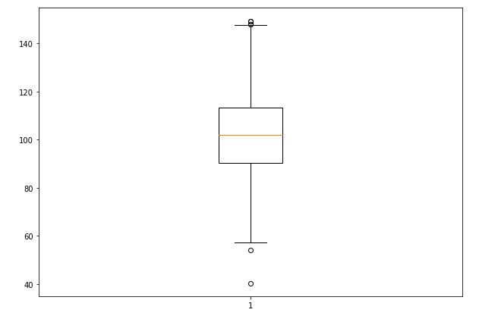
Matplotlib
Box Plot
Example:
import matplotlib.pyplot as plt
import numpy as np
# Creating dataset
np.random.seed(10)
data = np.random.normal(100, 20, 200)
fig = plt.figure(figsize =(10, 7))
# Creating plot
plt.boxplot(data)
# show plot
plt.show()
Output:

Slide 29
Matplotlib
Area Plot:
Area plots are pretty much similar to the line plot. They are also known as stack plots.
These plots can be used to track changes over time for two or more related groups that make up one whole category.
For example, let’s compile the work done during a day into categories, say sleeping, eating, working and playing.

Slide 30
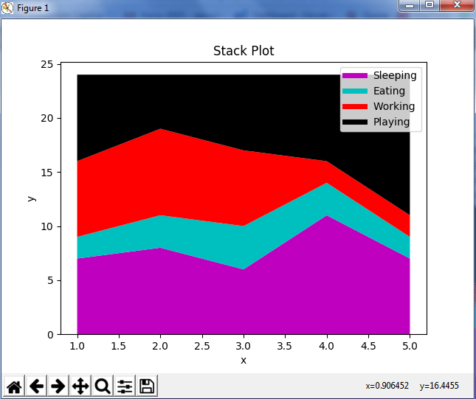
Matplotlib
Area Plot
import matplotlib.pyplot as plt
days = [1,2,3,4,5], sleeping =[7,8,6,11,7]
eating = [2,3,4,3,2] , working =[7,8,7,2,2]
playing = [8,5,7,8,13]
plt.plot([],[],color='m', label='Sleeping', linewidth=5)
plt.plot([],[],color='c', label='Eating', linewidth=5)
plt.plot([],[],color='r', label='Working', linewidth=5)
plt.plot([],[],color='k', label='Playing', linewidth=5)
plt.stackplot(days, sleeping,eating,working,playing,
colors=['m','c','r','k'])
plt.xlabel('x')
plt.ylabel('y')
plt.title('Stack Plot')
plt.legend()
plt.show()
Output:

Slide 31
Matplotlib
Pie Chart:
A pie chart refers to a circular graph which is broken down into segments i.e. slices of pie.
It is basically used to show the percentage or proportional data where each slice of pie represents a category.

Slide 32
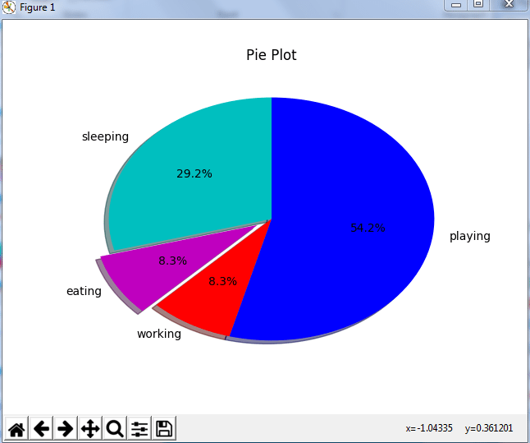
Matplotlib
Pie Chart
import matplotlib.pyplot as plt
days = [1,2,3,4,5],
sleeping =[7,8,6,11,7]
eating = [2,3,4,3,2]
working =[7,8,7,2,2]
playing = [8,5,7,8,13]
slices = [7,2,2,13]
activities = ['sleeping','eating','working','playing']
cols = ['c','m','r','b']
plt.pie(slices, labels=activities, colors=cols,
startangle=90, shadow= True, explode=(0,0.1,0,0),
autopct='%1.1f%%')
plt.title('Pie Plot')
plt.show()
Output:

Slide 33

Matplotlib
Subplots
A subplot is used to display multiple plots in the same window.
Subplot arranges plots in a regular grid.
To draw the subplots specify the number of rows, columns, and plot.
The syntax for subplot is shown below.
It divides the current window into an m by n grid and creates an axis for the subplot in the position specified by p.
For example, Subplot(2,1,2) creates two subplots, which are stacked vertically on a grid.
If we want to plot four graphs in one window, then the syntax used should be Subplot(2,1,4).

Slide 34
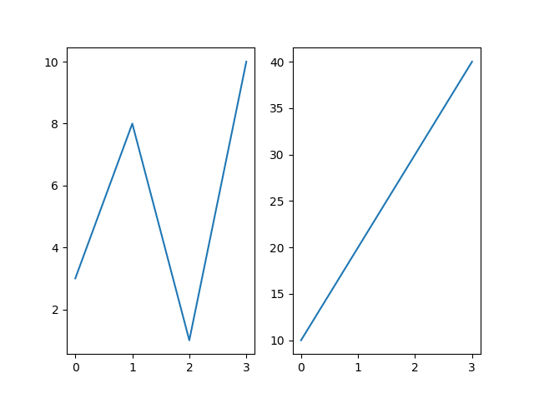
Matplotlib
Subplots
import matplotlib.pyplot as plt
#plot 1:
x = np.array([0, 1, 2, 3])
y = np.array([3, 8, 1, 10])
plt.subplot(1, 2, 1)
plt.plot(x,y)
#plot 2:
x = np.array([0, 1, 2, 3])
y = np.array([10, 20, 30, 40])
plt.subplot(1, 2, 2)
plt.plot(x,y)
plt.show()

Slide 35
Thank You

